Slide 1
The More You Know: Up the Ante on Your Knowledge of Opioid Use Disorder

Slide 2

Your Hosts
Maria Foy, PharmD, BCPS, CPE, Advanced clinical pharmacy specialist, pain Management Jefferson Abington Hospital
Tanya Uritsky, PharmD, BCCP Opioid Stewardship coordinator Hospital of the University of Pennsylvania

Slide 3
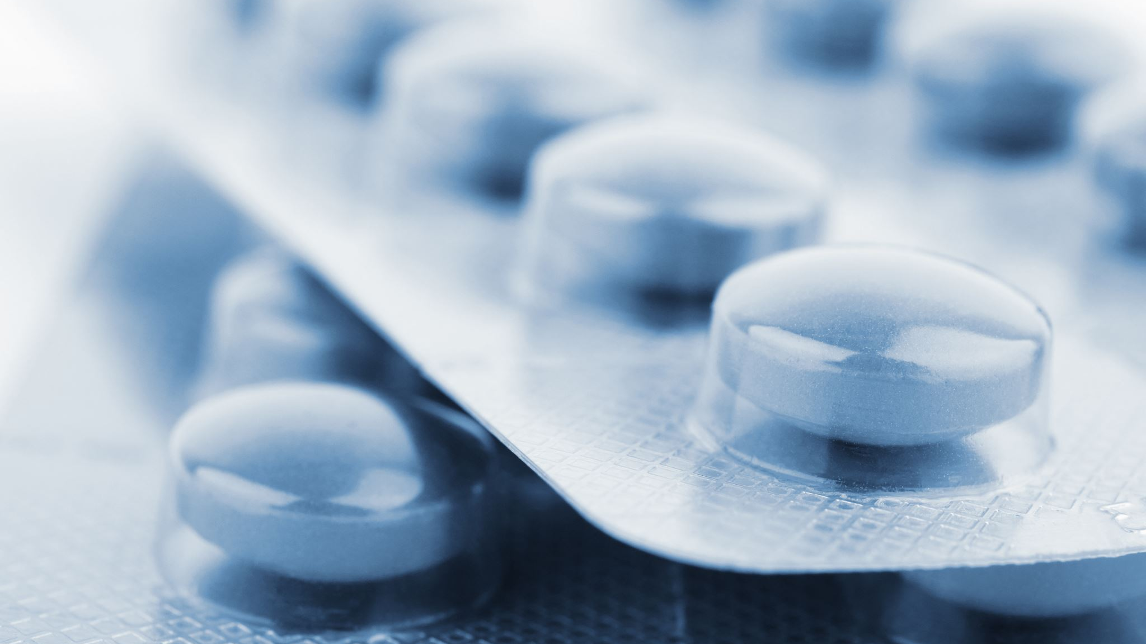
Goals and Objectives
Recognize various types of harm reduction in the care of patients with OUD
Discuss MOUD selection and how fentanyl is changing induction strategies and opioid withdrawal management
Identify types of stigma that impact patients with OUD
Select appropriate strategies to managing pain in patients with OUD
Notes:
Recognize various types of harm reduction in the care of patients with OUD Assessment Questions Game show questions 2.1 Patient-centered care Choose a domain. Choose a domain.
2. Discuss MOUD selection and how fentanyl is changing induction strategies and opioid withdrawal management Case studies; Assessment Questions Game show questions; case-based learning 2.1 Patient-centered care 2.4 Population-based care Choose a domain.
3. Identify types of stigma that impact patients with OUD. Assessment Questions Game show questions 3.3 Patient advocacy Choose a domain. Choose a domain.
4. Select appropriate strategies to managing pain in patients with OUD Assessment Questions; Case studies Game show questions; case-based learning 2.1 Patient-centered care Choose a domain. Choose a domain.
5. Identify ways that pharmacists can contribute to the care of patients with OUD across care settings.

Slide 4
Stigma
MOUD
Pain Management
Harm reduction
Withdrawal
Screening
$200
$200
$200
$200
$200
$200
$400
$400
$400
$400
$400
$400
$600
$600
$600
$600
$600
$600
$800
$800
$800
$800
$800
$800
$1000
$1000
$1000
$1000
$1000
$1000

Slide 5
This is the preferred term to use in place of the term “addict.”
Stigma · $200

Slide 6
Avoids eliciting negative associations, punitive attitudes, and individual blame.
What is “person with Substance Use Disorder”?
Available at: https://nida.nih.gov/nidamed-medical-health-professionals/health-professions-education/words-matter-terms-to-use-avoid-when-talking-about-addiction. Accessed October 23, 2022.

Slide 7
This refers to the type language that should be used to appropriately refer to patients with opioid use disorder.
Stigma · $400

Slide 8
Medically accurate and current
Puts the person before the condition/behavior, rather than defining them by it
Evidence-based way of reducing stigma in health care & on a societal level
What is Person-first language?

Slide 9
This type of stigma leads people with substance use disorders to disengage from care.
Stigma · $600

Slide 10
Associated with psychological distress and poorer quality of life, continued substance use, reduced engagement with substance use treatment¹
No evidence of direct correlation of stigma related to OUD with retention in care¹
Stigma of methadone treatment¹
What is anticipated stigma?
<20% of Americans were willing to associate as a friend, colleague, or neighbor with someone addicted to prescription opioids²
44% of respondents believed that OUD indicates a lack of willpower²
32% believed a character defect or bad parenting caused OUD²
1. Tsai AC, et al. PLoS Med. 2019;16(11): e1002969; 2. The Associated Press-NORC Center for Public Affairs Research. Americans Recognize the Growing Problem of Opioid Addiction.” April 2018. Accessed 3/28/22. Available at: https://apnorc.org/projects/americans-recognize-the-growing-problem-of-opioid-addiction/
Notes:
Fix spacing of box

Slide 11
This type of stigma is encoded in cultural norms, laws, and institutional policies.
Stigma · $800

Slide 12
Restrictions on rights or opportunities in stigmatized groups
How care is financed and delivered
Criminalization of possession and distribution of certain substances
Relative contraindication to certain treatments and care settings
Healthcare providers with SUDs
What is structural stigma?

Slide 13
This term has fallen out of favor as it implies that the drug is a victim.
Stigma · $1000

Slide 14

The term “abuse” was found to have a high association with negative judgments and punishment.⁹
Legitimate use of prescription medications is limited to their use as prescribed by the person to whom they are prescribed. Consumption outside these parameters is misuse.
The word “abuse” makes the substance the victim.
What is “abuse”?
Available at: https://nida.nih.gov/nidamed-medical-health-professionals/health-professions-education/words-matter-terms-to-use-avoid-when-talking-about-addiction. Accessed October 23, 2022.
Notes:
Fix spacing

Slide 15
This MOUD therapy is a full opioid agonist, has variable pharmacokinetics, and can lead to QTc prolongation.
MOUD · $200

Slide 16
Methadone has been used since the 1940’s for pain and for the treatment of opioid use disorder
Methadone has a variable half-life (5-130 hours), susceptibility to CYP interactions, & has a large volume of distribution (1-8 L/kg) contributing to high interpatient variability
Methadone can lead to a delay in ventricular repolarization, leading to an increase in the QTc interval
What is methadone?
Am J Health-Syst Pharm. 2019;76:1097-1104.

Slide 17
This MOUD therapy is an opioid antagonist and can also be used for the treatment of alcohol use disorder.
MOUD · $400

Slide 18
Naltrexone is an opioid antagonist that is used for the treatment of OUD and alcohol use disorder
It is available as a tablet and extended-release depot injection
Variable kinetics with IM formulation
Adjunctive behavioral therapy recommended
Patients should be free of opioids for 7+ days prior to dose initiation
What is naltrexone?
Am J Health-Syst Pharm. 2019;76:1097-1104.

Slide 19
This is the amount of time that patients should be reassessed after receiving an initial induction dose of buprenorphine.
MOUD · $600

Slide 20
Dosing can be difficult when initiating buprenorphine/naloxone as it is not a one-size (or dose) fits all therapy.
Patients should be re-assessed after 30-60 minutes via COWS for symptom improvement and/or repeat dosing.
What is 30-60 Minutes?

Slide 21
This dosing method initially uses small doses of buprenorphine that can be increased over time.
MOUD · $800

Slide 22
Low dose induction is a method that uses small doses of buprenorphine (~0.5 mg) sublingually/buccally or transdermal buprenorphine to reduce the risk of precipitated withdrawal.
Doses are then titrated up over one to 2 or more days.
This can be done for patients still on full opioid agonist therapy or patients who may be hesitant to initiate buprenorphine.
What is low dose induction (micro induction)?
JACEP Open. 2020;1(6):1712-22. Drug Alcohol Rev. 2020;39(5):588-94. Clin Toxicol. 2022 Jan 20;4;1-6.

Slide 23
This dosing method initially uses high daily doses (>24mg) of buprenorphine during the induction phase.
MOUD · $1000

Slide 24
Traditional induction dosing of buprenorphine is 8-16 mg/day.
This may not be enough for some patients with a high opioid tolerance.
A recent study have showed the safety & efficacy with 366 high-dose inductions (>12mg), including 138 doses of ≥ 28mg.
Take away: do not be afraid to give increasing doses of buprenorphine during induction .
What is Macrodosing?
JAMA Netw Open. 2021;4(7):e2117128.

Slide 25
This is the use of a combination of medications with different mechanisms of action to provide analgesia.
Pain Management - $200

Slide 26
When multiple agents from different classes of medications act on different target sites in the pain pathway, pain relief may be optimized. Combination therapy can prevent development of sensitized pain, may reduce or eliminate the need for opioids and lessen the risks of adverse effects.
What is multimodal analgesia?
J Pain Res. 2017 Nov 16;10:2687-2698
Ochsner J. 2015 Winter;15(4):408-12.
Notes:
Luo J, Min S. Postoperative pain management in the postanesthesia care unit: an update. J Pain Res. 2017 Nov 16;10:2687-2698
Beck DE, Margolin DA, Babin SF, Russo CT. Benefits of a Multimodal Regimen for Postsurgical Pain Management in Colorectal Surgery. Ochsner J. 2015 Winter;15(4):408-12

Slide 27
This MOUD therapy will not offer any analgesic benefit for comorbid pain in someone with substance use disorder.
Pain Management · $400

Slide 28
Naltrexone is an opioid antagonist structurally similar to naloxone with a longer duration of effect. Naltrexone will completely block the mu receptor, thereby not allowing analgesia from administered opioids.
What is naltrexone?
J Gen Intern Med. 2020 Dec;35(Suppl 3):945-953
Notes:
Veazie S, Mackey K, Peterson K, Bourne D. Managing Acute Pain in Patients Taking Medication for Opioid Use Disorder: a Rapid Review. J Gen Intern Med. 2020 Dec;35(Suppl 3):945-953
Vickers AP, Jolly A. Naltrexone and problems in pain management. BMJ. 2006 Jan 21;332(7534):132-3

Slide 29
This strategy can be used for pain treatment in patients with OUD on once daily dosing of buprenorphine or methadone.
Pain Management · $600
Notes:
the author, the publication date, the title of the page or article, the website name, and the URL.
Coffa D, Harter K, Smith B, et al. Acute Pain and Perioperative Pain Management in Opioid Use Disorder: pain control in patients on buprenorphine, methadone, and naltrexone. https://cha.com/wp-content/uploads/2019/01/SHOUT-GUIDELINE-periop-and-acute-pain-03-28-2018.pdf. Accessed September 15, 2020.

Slide 30
Once daily dosing of methadone and buprenorphine offer control of cravings, but analgesia duration is much shorter. Both methadone and buprenorphine have a duration of analgesia of approximately 4-8 hours compared to 24-48 hour suppression of cravings.
What is dividing the daily dose into multiple times daily?
Ann Intern Med. 2006 Jan 17;144(2):127-34

Slide 31
This pure mu opioid would be preferred for severe pain in someone on buprenorphine therapy for OUD.
Pain Management · $800
Notes:
Fix – [

Slide 32
Due to the high binding affinity of buprenorphine on the mu receptor, pain control with alternate opioid therapy is difficult. In order to provide pain management in someone with severe pain on higher doses of buprenorphine, a pure mu opioid agonist with a high binding affinity, such as hydromorphone or fentanyl should be used.
What is hydromorphone or fentanyl?
Pain Medicine, Volume 21, Issue 4, April 2020, Pages 714–723

Slide 33
This is the condition that results when opioid therapy leads to the reorganization of the neural pathways, causing an increase in pain severity.
Pain Management · $1000

Slide 34
Opioid induced hyperalgesia is a result of nociceptive sensitization and reorganization of the pain pathways that lead to a paradoxical response to opioid therapy. In these patients, pain may increase with increasing doses of opioids.
What is opioid induced hyperalgesia?
Pain Physician. 2011 Mar-Apr;14(2):145-61.
Notes:
Lee M, Silverman SM, Hansen H, Patel VB, Manchikanti L. A comprehensive review of opioid-induced hyperalgesia. Pain Physician. 2011 Mar-Apr;14(2):145-61

Slide 35
This is used to reverse opioid overdose.
Harm Reduction · $200

Slide 36
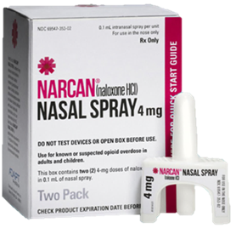
Naloxone saves lives.
Efficacy following naloxone administration by laypersons has been reported at 75–100%, and take-home naloxone programs are considered effective for reducing opioid-induced respiratory depression mortality.
Ensure patients with OUD are discharged with a naloxone in hand.
Educate patients on importance of naloxone.
Important to provide for any patient at risk for accidental overdose
What is naloxone?
Rzasa LR, Galinkin JL. Ther Adv Drug Saf. 2018; 9(1):63-88.
Notes:
Rzasa Lynn R, Galinkin JL. Naloxone dosage for opioid reversal: current evidence and clinical implications. Ther Adv Drug Saf. 2018;9(1):63-88. doi:10.1177/2042098617744161

Slide 37
These can be used to test substances for the presence of illicit fentanyl.
Harm Reduction · $400

Slide 38
Used to identify fentanyl in substances
Decriminalization of fentanyl test strips was approved in the PA House in June 2022
For an educational video on how to use fentanyl test strips go to: https://penncamp.org/the-risk-of-fentanyl/
For supplies: https://nextdistro.org/
What are fentanyl test strips?
Notes:
Currently, Section 780-113 (33) of the Controlled Substance Act prohibits the use or possession of drug paraphernalia for various purposes, and fentanyl test strips are considered "drug paraphernalia,” chargeable as an ungraded misdemeanor offense and punishable by up to 1 year in prison and up to $2,500 in fines.

Slide 39
What are fentanyl test strips?

Slide 40
Ensuring patients have access to this form of harm reduction reduces transmission of infectious diseases
Harm Reduction · $600

Slide 41
Syringe service programs (SSPs) distribute sterile syringes, safer drug use supplies, and education to people who inject drugs.
These harm reduction programs reduce HIV and HCV infection rates by about 50%.
What are sterile syringes
Available at: https://www.cdc.gov/ssp/syringe-services-programs-factsheet.html. Accessed October 22, 2022.

Slide 42
Addressing this when you see it contributes to reducing harms.
Harm reduction · $800

Slide 43
Often based on myth, prejudice, or superstition associated with a specific group of people, usually considered “undesirable” in society
The mental impact of stigma can worsen depression/anxiety.
Has a greater impact on negative quality of life than other social determinants of health
What is stigma?
1. Villa L. Shaming the Sick: Addiction and Stigma, American Addiction Centers. Available at: https://drugabuse.com/addiction/stigma/. Accessed Oct 26, 2021 2. Kulesza M, et al. Stigma among individuals with substance use disorders: Does it predict substance use, and does it diminish with treatment? J Addict BehavTher Rehabil. 2014;3(1):1000115.

Slide 44
This is prescribed to decrease the transmission of HIV in patients with injection drug use.
Harm reduction · $1000

Slide 45
Pre-exposure prophylaxis (or PrEP) is taken to prevent getting HIV.
Emtricitabine/Tenofovir
PrEP reduces the risk of getting HIV from injection drug use by at least 74%.
What is PREP (pre-exposure prophylaxis)?
Available at: https://www.cdc.gov/hiv/risk/prep/index.html. Accessed October 23, 2022

Slide 46
This observer-rated assessment tool is used to quantify the degree of opioid withdrawal.
Withdrawal - $200

Slide 47
The Clinical Opiate Withdrawal Scale (COWS) is a validated, 11 item clinician administered scale used to rate opioid withdrawal symptoms. The total score can help clinicians determine stage and severity of withdrawal at that point in time.
What is the Clinical Opiate Withdrawal Scale (COWS)?
J Psychoactive Drugs, 35(2), 253–9
Notes:
Wesson, D. R., & Ling, W. (2003). The Clinical Opiate Withdrawal Scale (COWS). J Psychoactive Drugs, 35(2), 253–9.

Slide 48
Peak of withdrawal symptoms are usually seen after this amount of time after last administered dose of short-acting opioid.
Withdrawal · $400

Slide 49
Onset of withdrawal symptoms is dependent on half-life of the specific opioid. Withdrawal from short acting opioids is seen at about 12 hours after last dose, peaks at 36-72 hours, and lasts 7-10 days. Onset and duration of withdrawal from long-acting opioids are later and protracted, but symptoms may be less intense.
What Is 36-72 hours?
Am J Addict. 2019 Feb;28(2):55-62.
Clin Pharm Ther. 2020; 45: 892– 903
Notes:
The severity and duration of OWS varies as a function of the half‐life of the opioid, the duration of opioid use, and patient‐specific characteristics including health status. Abrupt cessation of short‐acting opioids (eg, heroin, hydrocodone, and oxycodone) is associated with severe OWS that typically begin within 12 hours after a missed dose, peak at 36–72 hours, and gradually taper off over the following 4–7 days. Withdrawal from buprenorphine, a long‐acting opioid, can be less severe than withdrawal from short‐acting opioids and of similar duration. Withdrawal from methadone also produces milder symptoms; however, they may last 2 weeks or more
Kosten TR, Baxter LE. Review article: Effective management of opioid withdrawal symptoms: A gateway to opioid dependence treatment. Am J Addict. 2019 Feb;28(2):55-62. doi: 10.1111/ajad.12862. Epub 2019 Jan 31. PMID: 30701615; PMCID: PMC6590307.
Opioid withdrawal symptoms can be very uncomfortable, but are usually not life-threatening. The onset of OWS after the last opioid exposure is variable, reflecting the half-life of the specific opioid used. For example, heroin withdrawal symptoms usually begin within 12 hours of last usage, peak within 36-72 hours and last for 7-10 days. Fentanyl, another short-acting opioid, has a similar profile to heroin, with symptoms starting 8-16 hours after discontinuation, reaching maximum intensity in 36-72 hours and lasting 5-8 days.31 In contrast, methadone withdrawal symptoms typically start within 30 hours of last exposure, peak at 72-96 hours and last for ≥14 days
Pergolizzi, JV, Raffa, RB, Rosenblatt, MH. Opioid withdrawal symptoms, a consequence of chronic opioid use and opioid use disorder: Current understanding and approaches to management. J Clin Pharm Ther. 2020; 45: 892– 903

Slide 50
This atypical antipsychotic can be used for agitation, nausea and sleep in a patient with opioid use disorder.
Withdrawal · $600

Slide 51
Literature has supported use of olanzapine for withdrawal symptoms. In a study comparing olanzapine with chlorpromazine, olanzapine showed benefit in sleep, appetite, restlessness, agitation and cravings. Olanzapine has also been shown to help with nausea with minimal QTC prolongation.
What is olanzapine?
Psychiatry and Clinical Psychopharmacology. 2014; 24: supplement S324-325. Accessed on-line Dec. 2023
Notes:
Kosten TR, Baxter LE. Review article: Effective management of opioid withdrawal symptoms: A gateway to opioid dependence treatment. Am J Addict. 2019 Feb;28(2):55-62

Slide 52
This class of medication needs to be continued as a bridge during low dose buprenorphine induction to prevent withdrawal symptoms.
Withdrawal $800

Slide 53
Bridging during low dose BUP induction with a full dose agonist allows the slow load of the high affinity medication (BUP) without significant displacing of the full agonist, thereby preventing precipitated withdrawal. The full dose agonist is titrated downward as BUP is up-titrated resulting in a smooth transition to BUP.
What is a full mu opioid agonist?
The Canadian Journal of Addiction. 2019dec; 10 (4):41-50
Notes:
Ghosh, Sumantra Monty MD, MSc, FRCPC, ISAM1 ; Klaire, Sukhpreet MD, CCFP2 ; Tanguay, Robert MD, FRCPC, ISAM3 ; Manek, Mandy MD, CCFP4 ; Azar, Pouya MD, FRCPC, ISAM5 A Review of Novel Methods To Support The Transition From Methadone and Other Full Agonist Opioids To Buprenorphine/Naloxone Sublingual In Both Community and Acute Care Settings, The Canadian Journal of Addiction: December 2019 - Volume 10 Issue 4 - p 41-50

Slide 54
Xylazine is structurally similar to this blood pressure lowering medication, which is commonly used to treat opioid withdrawal and presumed xylazine withdrawal
Withdrawal· $1000

Slide 55
Xylazine is structurally similar to alpha agonists, such as clonidine, tizanidine and guanfacine. Scheduled clonidine, if BP allows, can be tried for xylazine withdrawal. If BP is soft, tizanidine can be used.
What is clonidine?
Ehrman-Dupre, Rachel MD; Kaigh, Caroline MD; Salzman, Matt MD; Haroz, Rachel MD; Peterson, Lars-Kristofer MD; Schmidt, Ryan MD. Management of Xylazine Withdrawal in a Hospitalized Patient: A Case Report. Journal of Addiction Medicine 16(5):p 595-598, 9/10 2022.
Notes:
NIDA. 2018, May 16. FDA approves first medication to reduce opioid withdrawal symptoms. Retrieved from https://nida.nih.gov/news-events/news-releases/2018/05/fda-approves-first-medication-to-reduce-opioid-withdrawal-symptoms on 2022, October 23

Slide 56
This type of intervention (or interviewing technique) is a way of encouraging patients to commit to changes in their substance use.
Screening· $200

Slide 57
Motivational interviewing is an evidence-based technique for helping patients resolve ambivalence about behaviors that prevent change.
The goal is to express empathy & elicit a client’s reasons for changing SUD habits.
4 core processes are PACE: Partnership, Acceptance, Compassion, and Evocation
What is motivational interviewing?
Samhsa. https://store.samhsa.gov/sites/default/files/SAMHSA_Digital_Download/PEP20-02-02-014.pdf

Slide 58
Although heroin is still commonly used to refer to the illicit opioid supply, this opioid now makes up the majority of the illicit opioid supply in the U.S.
Screening· $400

Slide 59
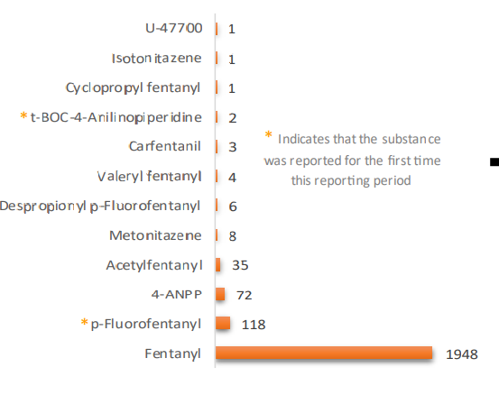
According to the DEA emerging threat report in 2021, fentanyl accounted for 89% of the opioid identifications.
A major concern is the increase in fentanyl analogues (or fentalogs).
What is fentanyl?
https://cesar.umd.edu/sites/cesar.umd.edu/files/pubs/DEA-Emerging-Threat-Report-2021-Mid-Year.pdf

Slide 60
This is one of the active metabolites of heroin and can be found on a urine drug toxicology screen.
Screening - $600

Slide 61
Also abbreviated as 6 –MAM
Diacetylmorphine (or heroin) is metabolized with 6-AM being one of the metabolites. 6-AM is not a metabolite of other typically used opioids.
6-AM can be found in some commercially available UDS tests & if 6-AM is positive, this is indicative that heroin was used.
What is 6-Monoacetylmorphine (6-AM)?
Int J Clin Pract. 2010;64:1712-8.
Notes:
Add MAM

Slide 62
A common motivational interviewing technique uses the acronym, SBIRT, where S is screening, BI is brief intervention, and RT refers to this.
Screening· $800

Slide 63
SBIRT is a comprehensive approach to delivery of early intervention for patients with substance use disorders.
A newer derivative of SBIRT is SBIIRT, which includes “Induction” of MOUD.
What is referral to treatment?
https://www.samhsa.gov/sbirt

Slide 64
This veterinary medication has been increasing in its prevalence in the US illicit opioid supply.
Screening· $1000

Slide 65
Xylazine has been found in the illicit opioid supply, especially in the northeast United States.
Potential treatments includes alpha agonist therapy combined with medications for symptom management. Naloxone will not reverse xylazine overdose but should be administered due to probability of fentanyl combined with xylazine. Xylazine test strips are now available.
What is xylazine?
Clin Toxicol. 2022;60:892-901

Slide 66
Final jeopardy

Slide 67
This is the estimated amount of oral morphine equivalents in one bag of IV fentanyl in Philadelphia.
Final jeopardy

Slide 68
What is 500-1000 mg.
Final jeopardy

Slide 69
Winner!

Slide 70
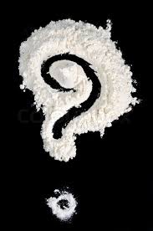
Questions?

Slide 71
Credits
Special thanks to all the people who made and released these awesome resources for free:
Presentation template by SlidesCarnival

